Slide 1

Software requirements (swr302)
Establishing the business requirements (chapter 05)

Slide 2
Business Requirements
A set of information that describes a need that leads to one or more projects to deliver a solution and the desired ultimate business outcomes
Business opportunities,
Business objectives,
Success metrics,
Vision statement
Business requirements issues must be resolved before the functional & nonfunctional requirements can be fully specified
A statement of the project’s scope and limitations helps greatly with discussions of proposed features and target releases
Provide a reference for making decisions about proposed requirement changes and enhancements
Notes:
Why & how to identify desired business benefits?
The business requirements set the context for, and enable the measurement of, the benefits the business hopes to achieve from undertaking a project.
- Organizations should not initiate any project without a clear understanding of the value it will add to the business.
- Set measurable targets with business objectives, and then define success metrics that allow you to measure whether you are on track to meet those objectives
Business requirements might come from funding sponsors, corporate executives, marketing managers, or product visionaries.
The business benefit has to represent a true value for the project’s sponsors and to the product’s customers.

Slide 3
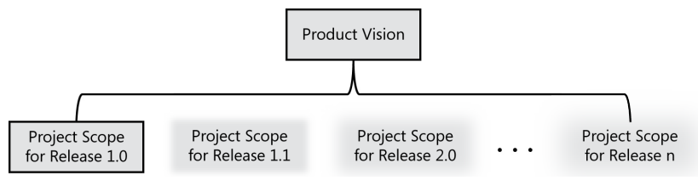
Business Requirements Product vision and Project scope
Core elements of the business requirements
The product vision succinctly describes the product/solution that will achieve the business objectives. The vision describes what the product is about and what it ultimately could become
The project scope identifies what portion of the ultimate product vision the current project or development iteration will address

Slide 4
Business Requirements Conflicting business requirements
Business requirements collected from multiple sources might conflict.
The project’s decision makers must resolve the conflicts before the analyst can detail the requirements
Uncontrolled scope creep, in which stakeholders overstuff the new system in an attempt to satisfy every interest, can cause the project to topple under its own weight.
A BA can help by surfacing potential areas of conflict and differing assumptions, flagging conflicting business objectives, noting when requested features don’t achieve those objectives, and facilitating conflict resolution
Long-duration projects often experience a change in decision makers partway through
Notes:
Overstuff: tang cường
Topple: lật đổ

Slide 5
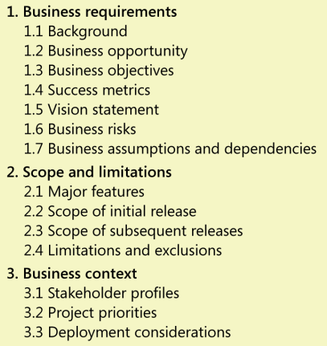
Vision and Scope Document
Collects the business requirements into a single deliverable that sets the stage for the subsequent development work.
A business case document
Project charter
The owner of the vision and scope document is the project’s executive sponsor, funding authority, or someone in a similar role. A business analyst can work with this individual to articulate the business requirements and write the vision and scope document.

Slide 6
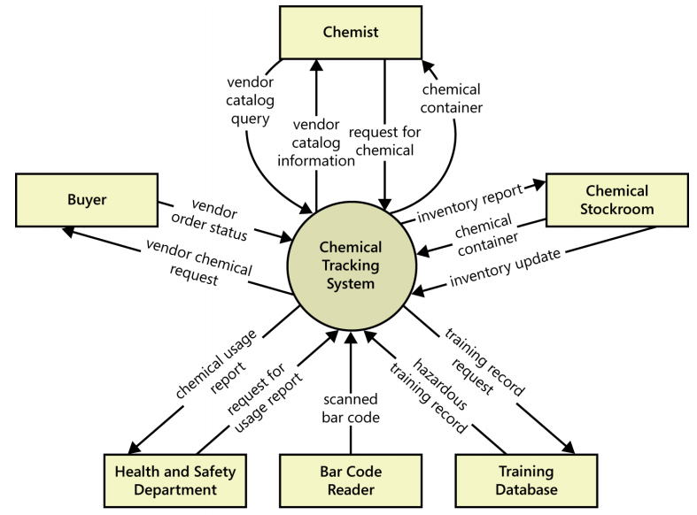
Scope representation techniques Context Diagram
Notes:
The external entities in the rectangles can represent user classes (Chemist, Buyer), organizations (Health and Safety Department), other systems (Training Database), or hardware devices (Bar Code Reader). The arrows on the diagram represent the flow of data (such as a request for a chemical) or physical items (such as a chemical container) between the system and its external entities.

Slide 7
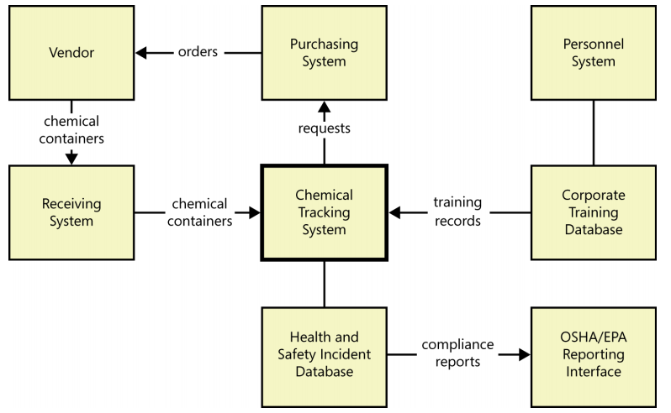
Scope representation techniques Ecosystem Map
Notes:
Ecosystem maps differ from context diagrams in that they show other systems that have a relationship with the system you’re working on, including those without direct interfaces. You can identify the affected systems by determining which ones consume data from your system. When you reach the point that your project does not affect any additional data, you’ve identified the scope boundary of systems that participate in the solution.

Slide 8
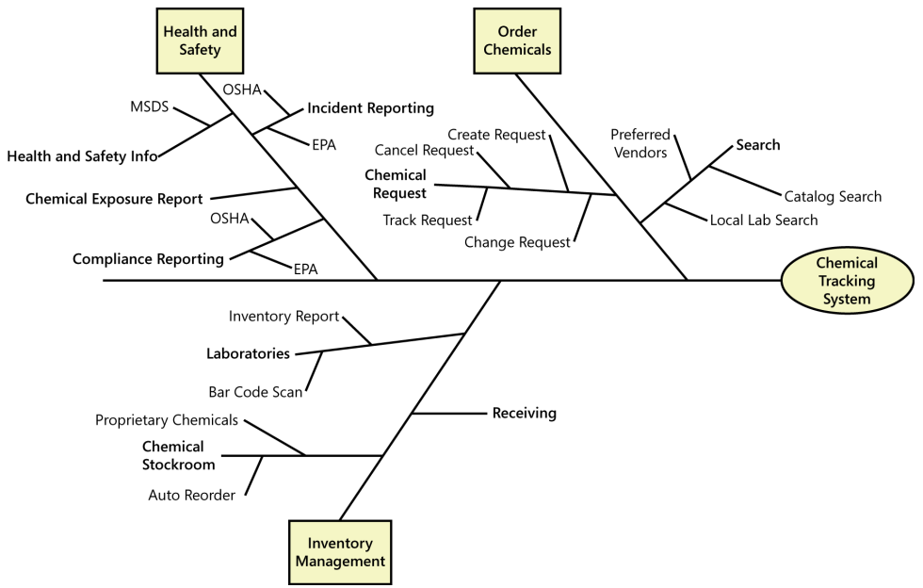
Scope representation techniques Feature Tree
Notes:
A feature tree is a visual depiction of the product’s features organized in logical groups, hierarchically subdividing each feature into further levels of detail.
The feature tree provides a concise view of all of the features planned for a project, making it an ideal model to show to executives who want a quick glance at the project scope. A feature tree can show up to three levels of features, commonly called level 1 (L1), level 2 (L2), and level 3 (L3). L2 features are subfeatures of L1 features, and L3 features are sub features of L2 features When planning a release or an iteration, you can define its scope by selecting a specific set of features and subfeatures to be implemented . You could implement a feature in its entirety in a specific release, or you could implement only a portion of it by choosing just certain L2 and L3 subfeatures.

Slide 9
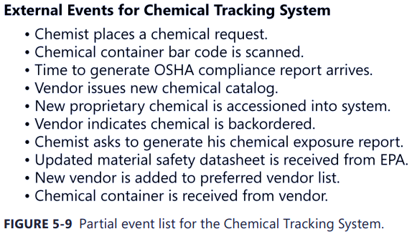
Scope representation techniques Event List
An event list identifies external events that could trigger behavior in the system. The event list depicts the scope boundary for the system by naming possible business events triggered by users, time-triggered (temporal) events, or signal events received from external components, such as hardware devices.
The event list only names the events; the functional requirements that describe how the system responds to the events would be detailed in the SRS by using event-response tables

Slide 10
Keeping the scope in focus
The business requirements and an understanding of how customers will use the product provide valuable tools for dealing with scope change
Change is within the scope -> priority
Change is out of scope & for future release or by another project only
Change is out of scope, but it’s such a good idea that the scope should be broadened to accommodate it, with corresponding changes in budget, schedule, and/or staff
The information in the vision and scope document lets you assess whether proposed requirements are appropriate for inclusion in the project
Using business objectives to make scoping decisions
Assessing the impact of scope changes

Slide 11
Vision and scope on agile projects
The scope of each iteration consists of user stories selected from a dynamic product backlog (Priority, Team capacity)
Instead of trying to fight scope creep, the team prioritizes new requirements against existing items in the backlog and allocates them to future iterations
Overall project duration still depends on the total amount of functionality to be implemented, but the scope of each iteration is controlled to ensure timely completion
The team can define a high-level roadmap of iterations at the beginning of the project, but the user story allocation for an iteration will be performed at the beginning of each iteration (Referencing the business requirements)

Slide 12


